Slide 1
Advanced database Topics
UNIVERSITY OF WINDSOR
Guided by: Dr. Kalyani selvarajah

Slide 2
Sentiment analysis of imdb movie reviews
Group No: 27
Group Members:
Kantrodiya Krunal Nareshbhai – (110023746)
Kalathiya Yash Pankajbhai – (110017138)
Kinresh Vishnubhai Patel – (110024432 )
Zadafia Gaurang Rameshbhai – (110011409 )
Pandya Abhinand – (110030852 )

Slide 3
Introduction
In the past few years web data analyzation has been receiving great attention to analyze the opinions of the user.
This increases the interest in the methods of automatically extracting and analyzing individual opinion from web documents.
We are doing this opinion analyzation on IMDB movie database where users have given their reviews for different movies and we are developed a system that analyzes the positivity or the negativity of the content.

Slide 4
Existing related work
The original work on this dataset was done by researchers at Stanford University. They used unsupervised learning to cluster the words with close semantics and created word vectors.
They have also worked on creating a multi-class classification of the review and predicting the reviewer rating of the movie/product. They ran various machine learning methods like Naive Bayes, and Maximum entropy to categorize the data.

Slide 5
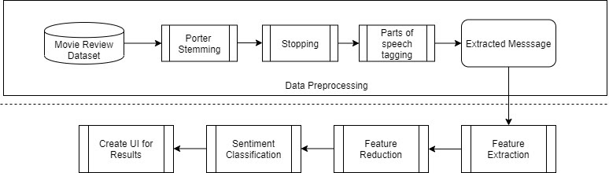
Step by step process of the project

Slide 6
DATA Preprocessing
In this we will be gathering the database and then preprocess it.
First, we’ll remove unwanted data from database which can slow the data processing. That includes removing the unwanted spaces/blank spaces, repeated data item to reduce redundancy and convert it into lower case.
Then we’ll do stemming of the data and remove all the stopping words from the data as it provides very little or no information about the data and it is unnecessary.
Part of speech tagging is a processing technique where the words are marked as nouns, verbs, adverbs, etc.

Slide 7
Feature extraction and reduction/selection
In this step we’ll do data analysis to find common patterns without disturbing the accuracy and the originality of the dataset so that accurate results can be derived.
After feature extraction, out of all the extracted features we’ll do feature selection, meaning we will rank all the features and ignore all the least required features so that it makes the entire process less time consuming.

Slide 8
Sentiment Classification and derived results
In the step classification of the sentiment feature will be done. Like positive, and negative.
To do that we’ll use bigram as vectorization method and use Support Vector Machine(SVM) to categorize the data.

Slide 9
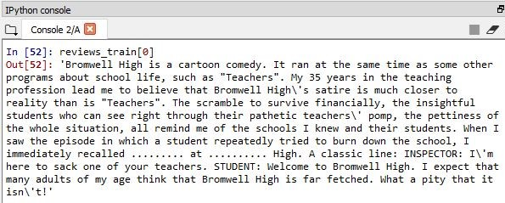
Screenshots of working model
This is the input file from the database

Slide 10
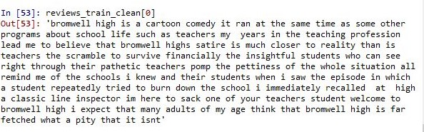
After removing all the blank spaces

Slide 11
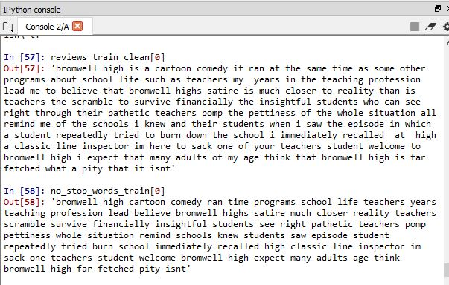
After removing all the stop words.

Slide 12
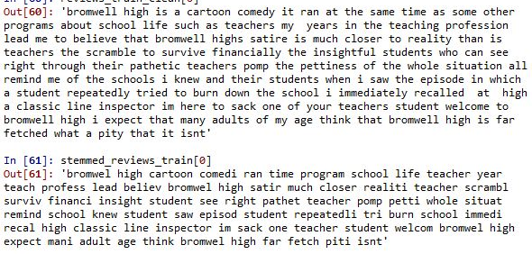
Stemmed data file

Slide 13
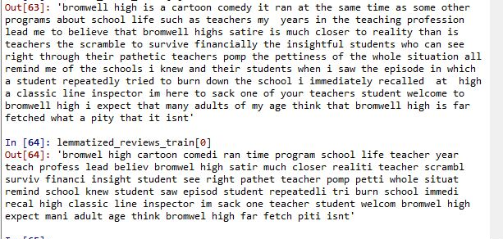
Lemmatized data file

Slide 14
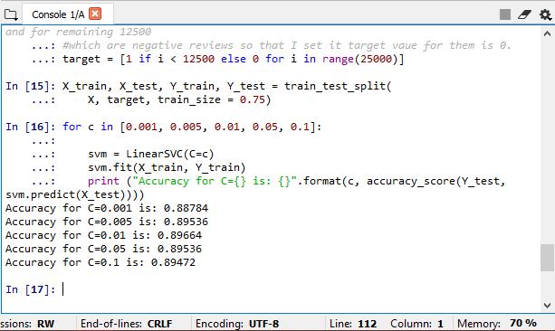
Accuracy of the final model

Slide 15
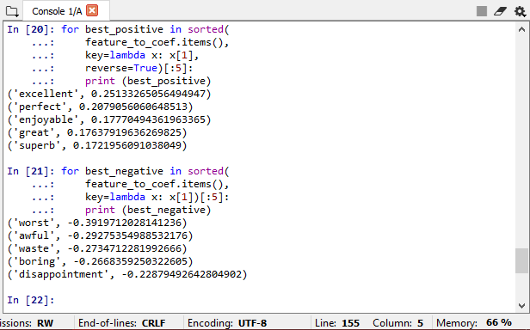
SVM Feature Extraction

Slide 16
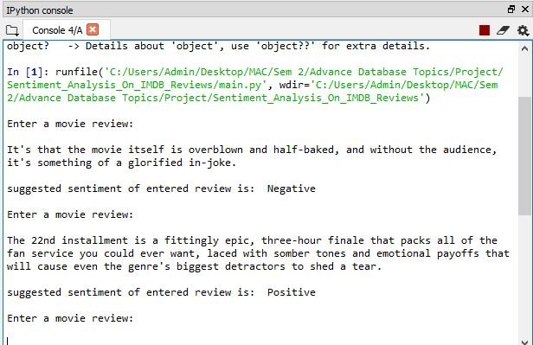
Final Output

Slide 17
Future scope
More classification of the review, i.e. not just positive or negative. Classification like strongly positive, weakly positive, strongly negative, weakly negative, and neutral.
Embedding this model to website and do real-time sentiment analysis.

Slide 18

QUESTIONS?

